Slide 1



Crop & Fertilizer Prediction System

Slide 2

Learning Objectives
Understand the importance of soil and environmental factors in crop selection and fertilizer recommendation.
Develop a machine learning model to predict crops and fertilizers based on key parameters.
Utilize AI-driven insights to help farmers improve crop yield and optimize fertilizer usage.
Ensure sustainability by reducing excessive fertilizer use and promoting precision agriculture.
Deploy a working model that takes user inputs and provides real-time recommendations.
GOAL
Source :
www.freepik.com/

Slide 3
Goal of the Project:
To develop an AI-based system that assists farmers in selecting the most suitable crop and fertilizer based on soil nutrients and environmental conditions.
To leverage machine learning algorithms for accurate predictions.
To promote efficient farming practices and sustainable agriculture through data-driven insights
GOAL
Source :
www.freepik.com/

Slide 4
Tools and Technology used
🔹 Programming Language: Python 🐍
🔹 Libraries & Frameworks: Pandas, NumPy, Scikit-Learn, Seaborn, Matplotlib
🔹 Machine Learning Model: Decision Tree Classifier
🔹 Data Processing: Label Encoding, Standardization
🔹 Model Deployment: Joblib (for saving and loading trained models)

Slide 5
Methodology
Step 1: Data Collection
Acquired datasets containing soil properties, environmental factors, and fertilizer recommendations.
Step 2: Data Preprocessing
Handled missing values and outliers in the dataset.
Categorical encoding applied to non-numeric data (Soil Type, Crop Type, Fertilizer Name).
Step 3: Model Training
Crop Prediction Model trained using Decision Tree Classifier.
Fertilizer Recommendation Model trained separately with relevant features.
Step 4: Model Evaluation
Accuracy tested using train-test split.
Confusion matrix & classification report used for performance analysis.
Step 5: Prediction Function
A function was developed to take NPK values, pH, temperature, humidity, and rainfall as input and recommend:
The best crop and The most suitable fertilizer

Slide 6
Problem Statement:
Challenges Faced by Farmers:
Uncertainty in crop selection due to varying soil fertility and climatic conditions.
Overuse or underuse of fertilizers leading to soil degradation.
Lack of accurate recommendations based on scientific analysis.
Inconsistent crop yield affecting profitability and food security.
Existing Challenges:
Farmers rely on traditional knowledge instead of data-driven decision-making.
Lack of awareness about optimal fertilizer usage.

Slide 7
Solution:
An AI-powered system that predicts the best crop and fertilizer based on:
Soil Nutrients (Nitrogen, Phosphorus, Potassium - NPK)
Environmental Factors (Temperature, Humidity, Rainfall, pH)
Soil Type & Crop Type
Key Benefits:
Data-Driven Recommendations for farmers.
Higher Crop Yield with the right crop selection.
Optimal Fertilizer Usage for soil health and sustainability.

Slide 8
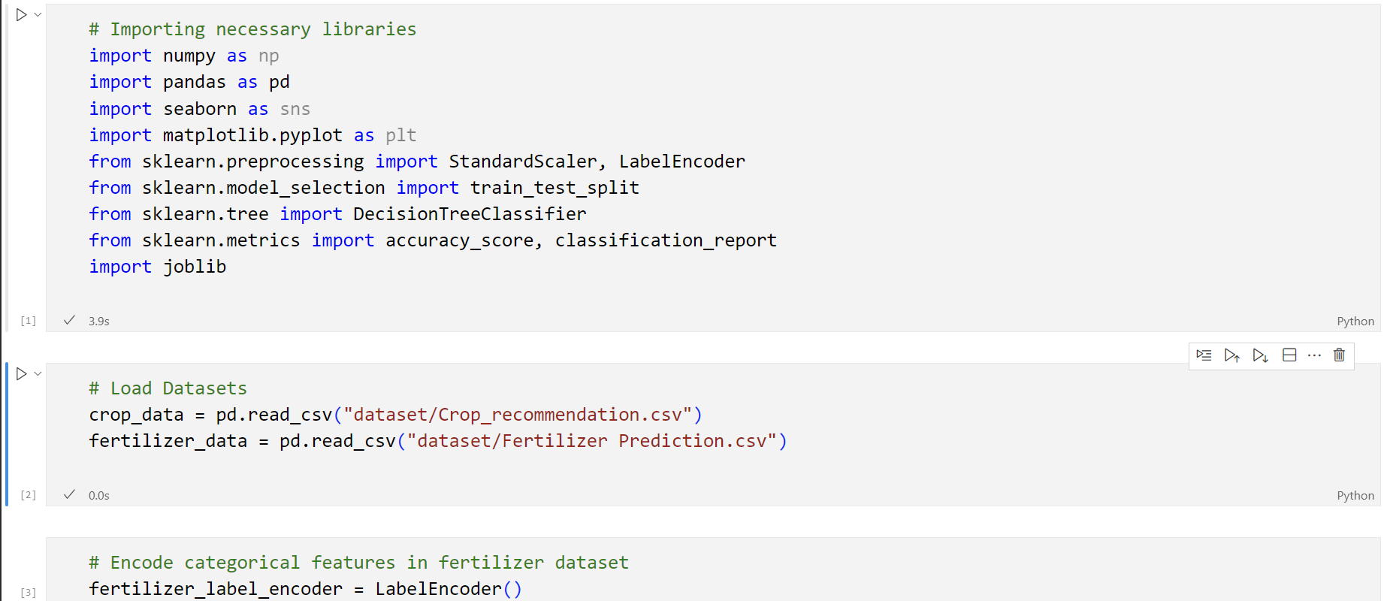

Slide 9
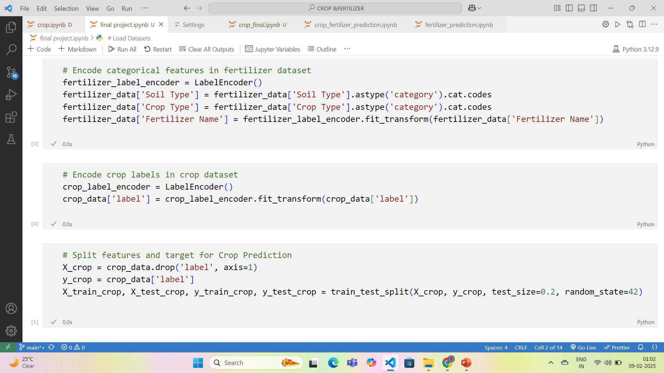
Screenshot of Output:

Slide 10
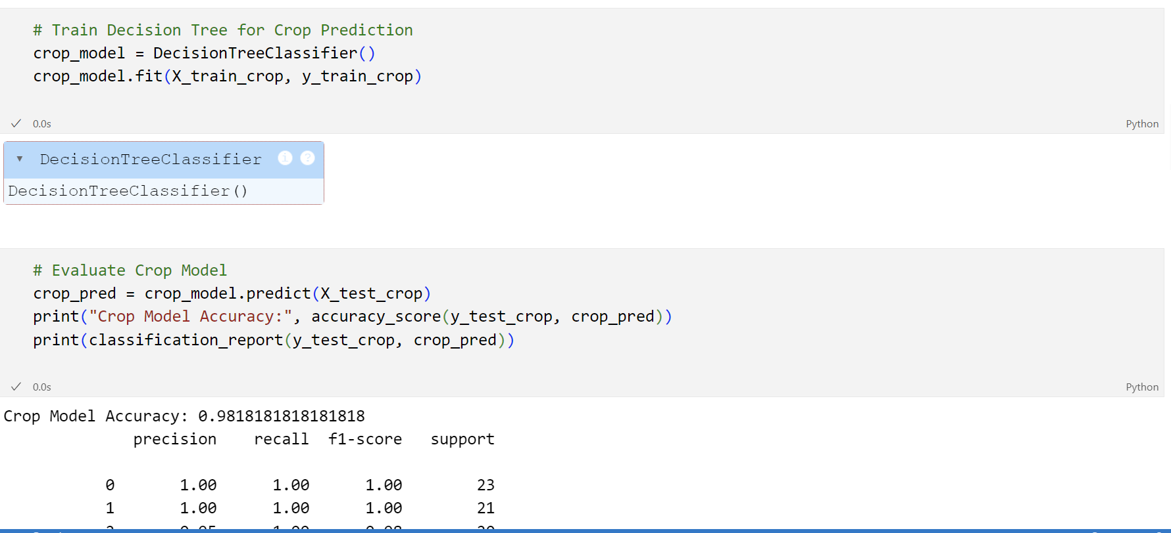

Slide 11
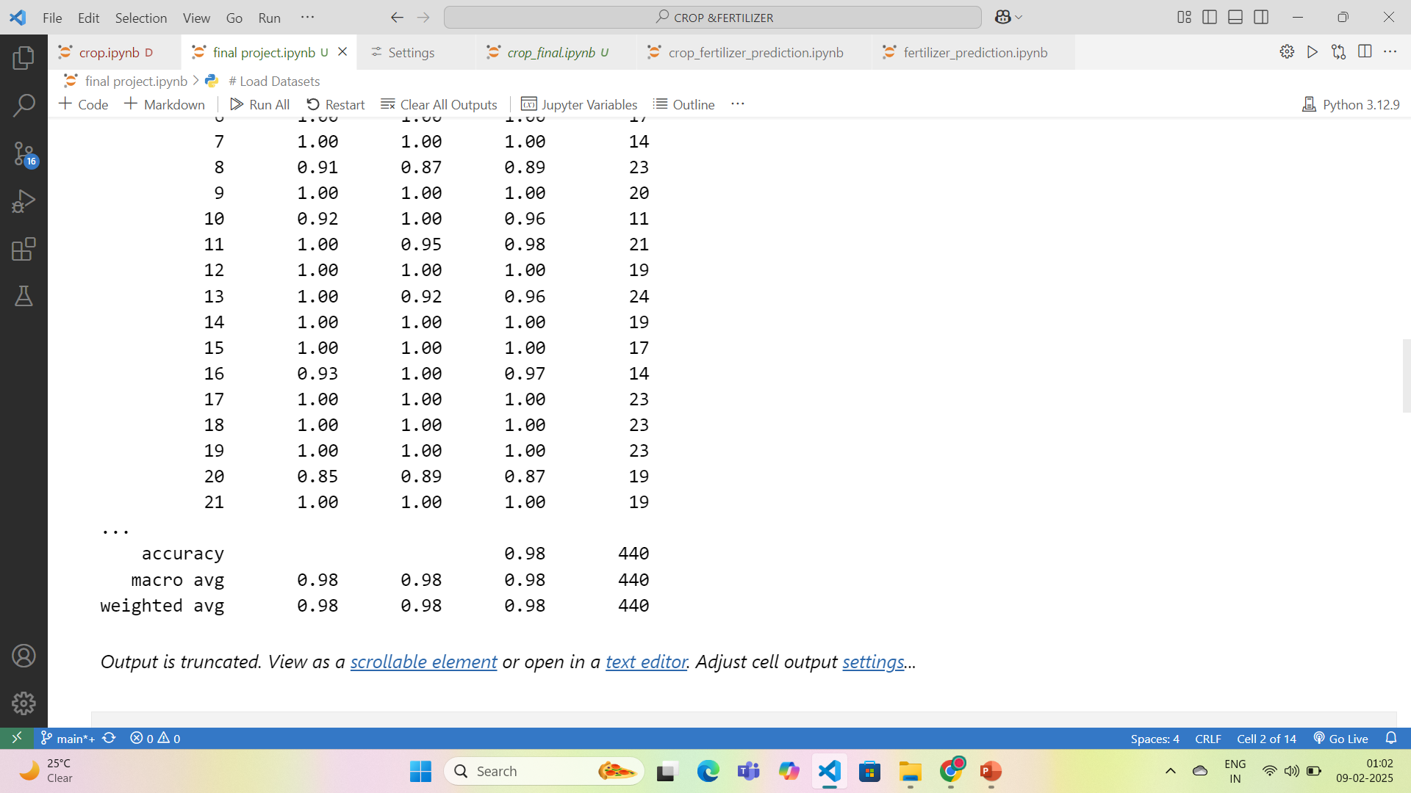

Slide 12
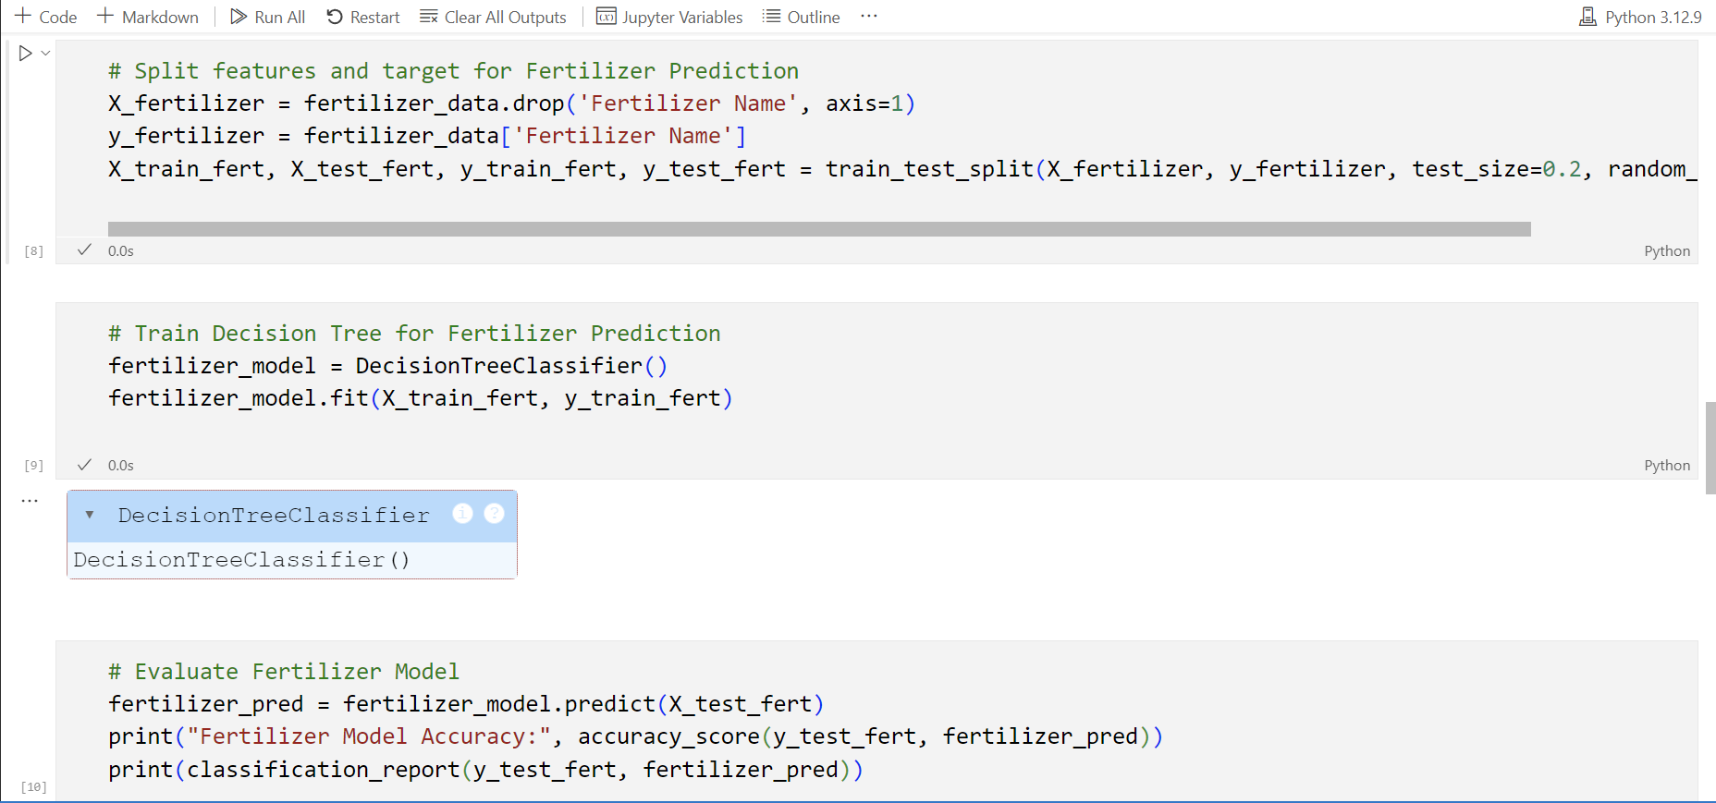

Slide 13
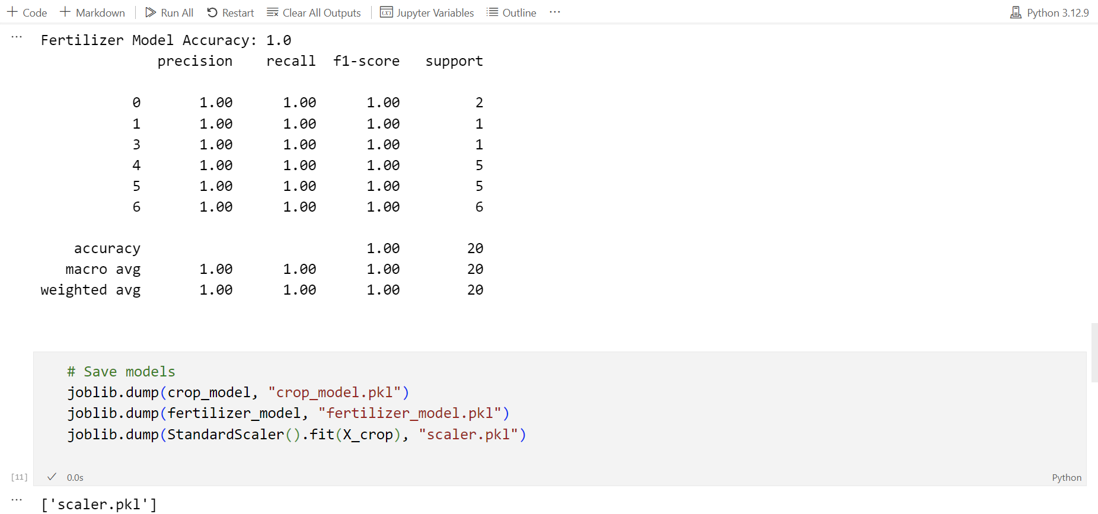

Slide 14
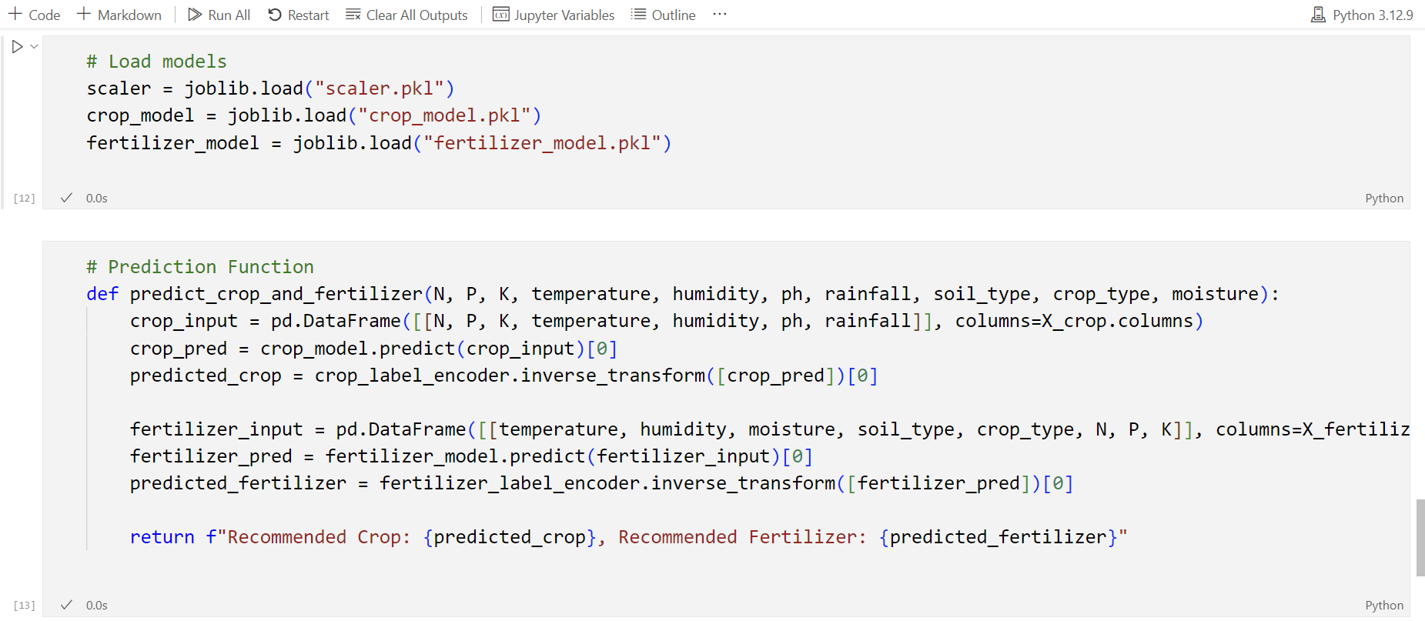

Slide 15
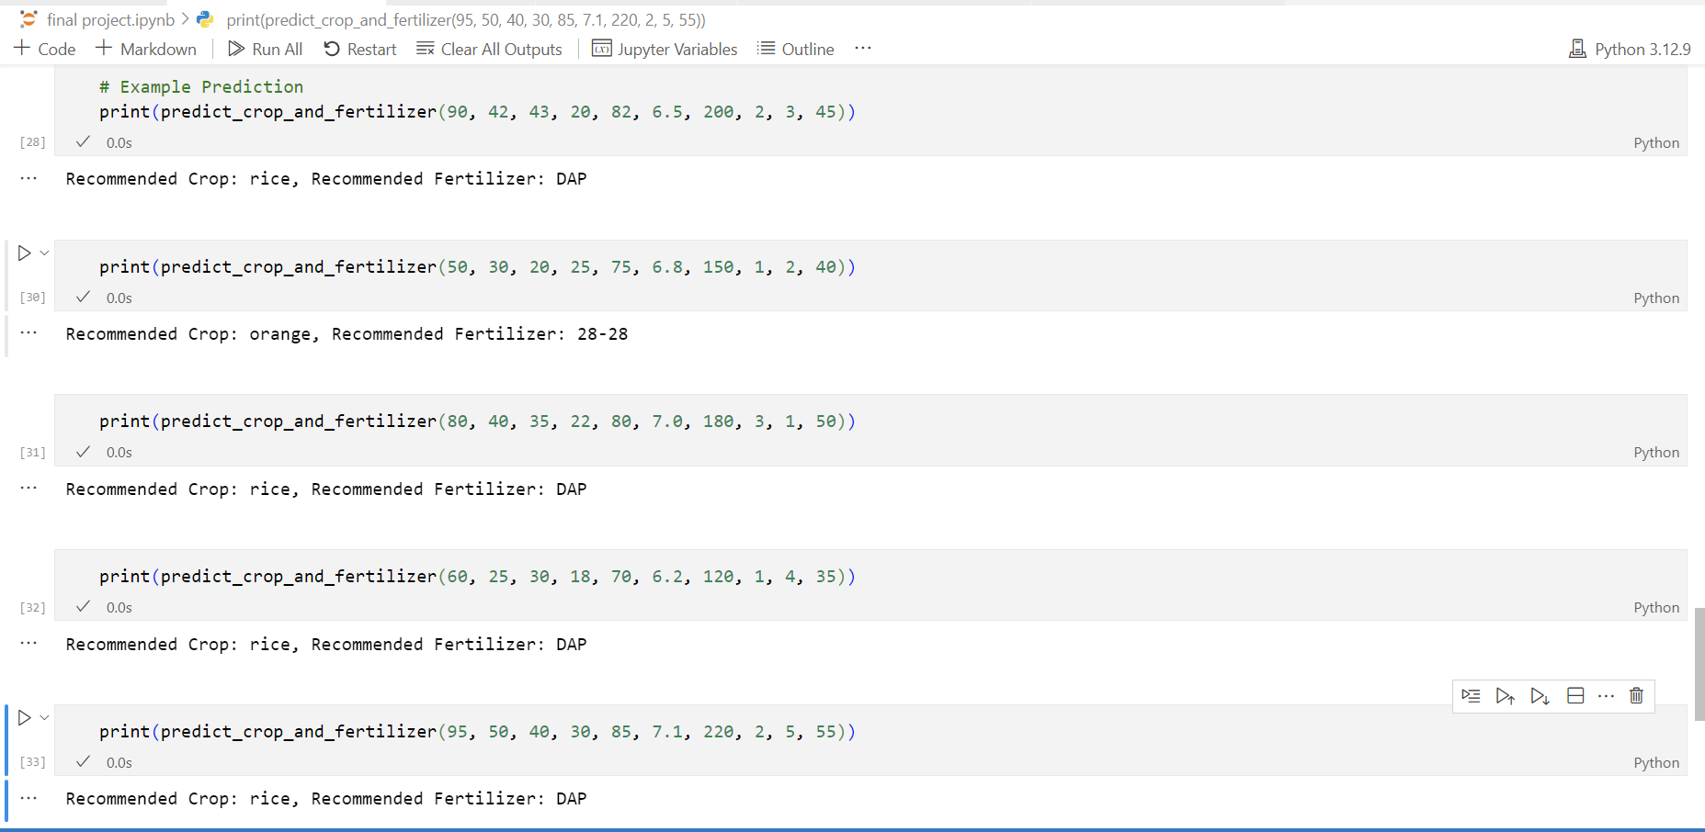

Slide 16
Conclusion:
The Crop & Fertilizer Prediction System ensures:
Accurate Crop Selection: Farmers can grow the most suitable crop based on soil properties.
Precision Farming: Avoid excessive fertilizer use and reduce soil damage.
Sustainable Agriculture: Balance between crop yield and environmental impact.
Empowering Farmers with AI: Improved decision-making through machine learning insights.
Future Scope:
Extending the model for multiple regions & soil types.
Implementing real-time IoT-based sensors for soil data collection.
Developing a user-friendly mobile application for farmers.

